Slide 1


INSTITUTION
SRM UNIVERSITY AP
TEAM CLOUDNINE
SAHIL RASAL - CSE AIML
VISIONARIES
MAHIP THAKORE- CSE
VSHASHANT PANDEY- CSE
SUDHIKSHA P - CSE
An AI-Driven Hyper-Local Early Warning System for Severe Weather Nowcasting.
AKARSH SHARMA - CSE
ANMOL VYAS— CSE AIML
MENTORS
SAHIL RASAL — AIML

Slide 2



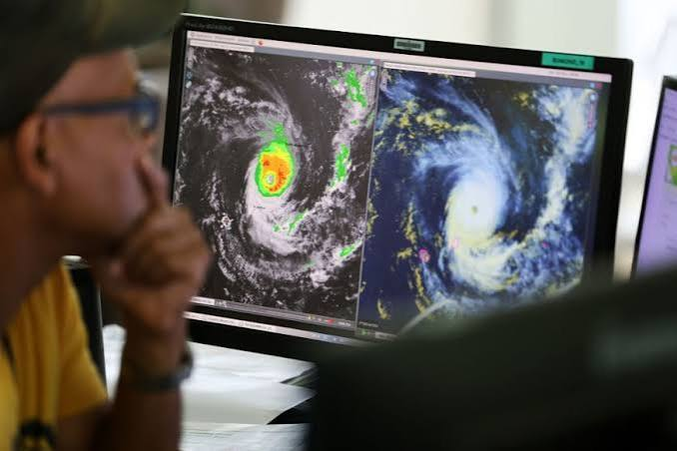
Problem Understanding
Traditional weather models take hours to compute, missing rapid-onset events like flash floods and microbursts within the critical 0-2 hour window.
•
The Gap: Numerical Weather Prediction (NWP) lacks hyper-local (neighborhood) resolution, resulting in warnings arriving *after* disaster strikes.
•
The Affected: Millions of farmers, daily wage commuters, municipal authorities, and aviation sectors across India.
2.5 Crore
Indians face severe daily life or economic disruptions due to unpredicted, sudden weather anomalies.

Slide 3






Proposed Solution
A deep learning system that treats radar data as a video prediction problem, generating real-time, hyper-local alerts in seconds, not hours.
1. Ingest
2. Predict
3. Overlay
4. Alert
IMD Radar & Satellite feeds (NetCDF format)
ConvLSTM AI model extrapolates 120-min trajectory
Cross-reference with topographical risk data
Geofenced push & SMS alerts to affected area
Key Differentiator: Unlike broad polygon warnings, our system utilizes a micro-grid approach (1km x 1km) to prevent public "alert fatigue" and provides predictions in under 3 seconds.

Slide 4


Technical Architecture
Core Tech Stack
Data Flow & APIs
•
AI / Model Training: Python, PyTorch, ConvLSTM networks, and Deep Generative Models of Radar (DGMR).
•
Input APIs: Scraping/parsing live feeds from the IMD Open Data Portal and INSAT-3D APIs.
•
Processing: Data is normalized; AI generates predicted radar reflectivity frames (dBZ).
•
Backend Infrastructure: FastAPI for high-speed model serving, PostgreSQL (PostGIS) for spatial data.
•
Threshold Engine: Logic layer determines if the predicted rain/wind breaches local vulnerability limits.
•
Frontend / Dashboard: React.js with Mapbox GL for smooth, real-time weather rendering.
•
Output APIs: Triggers Twilio/Msg91 APIs to dispatch targeted SMS to specific cell towers.
•
Cloud & Deployment: Dockerized containers deployed on AWS EC2, with Redis for caching.

Slide 5

Innovation & Novelty
Moving away from standard linear extrapolation (optical flow), our model uses Deep Generative AI to accurately "hallucinate" physical storm development and decay.
Feature | Traditional NWP Models | Project Nimbus (Our AI)
Processing Time | 2 to 4 hours | UndeUnder 3 seconds r 3 seconds
Spatial Resolution | Broad region / State level | Hyper-lHyper-local (1km x 1km grid) ocal (1km x 1km grid)
Alert Targeting | Mass broadcast (TV, Radio) | Precise geofenced SMS/Push
Foundation | Physics & fluid dynamics equations | Data-driven Convolutional LSTMs

Slide 6



Feasibility & Viability
36-Hour Buildability
Highly feasible. We are utilizing pre-trained foundational AI models (open-source) and will fine-tune them on a specific 3-year subset of historical IMD data during the hackathon to demonstrate a working MVP.
Resources Required
•
Open-source IMD historical NetCDF datasets.
•
Free-tier AWS instances for backend routing.
Scalability
•
Standard open-source Python/PyTorch libraries.
Because the AI inference is stateless, the model can be deployed locally on edge devices at remote weather stations. This prevents central server bottlenecks, allowing the system to easily handle 1000x user notification loads.
•
Zero proprietary hardware required.

Slide 7


Impact & Benefits
45 Min
10,000+
SDG 11 & 13
Time Saved: Increases the critical response window for emergency services before impact.
Lives Protected: Annually, by targeting highly vulnerable, flood-prone urban and rural sectors.
Alignment: Directly supports Sustainable Cities & Communities, and Global Climate Action initiatives.
Who Specifically Benefits?
•
State Disaster Management Authorities (SDMA): Gain a real-time command dashboard for preemptive action.
•
Agriculture Sector: Local farmers receive exact rainfall windows to protect harvested crops.
•
General Public: Commuters avoid flooded underpasses and deadly urban traffic gridlocks.

Slide 8


Working Prototype
The Citizen Experience
Our MVP demonstrates the end-to-end flow: from AI prediction generation to the final user alert.
•
Precision Targeting: Alerts are only triggered if the user's GPS pings inside the predicted 1km danger polygon.
•
Actionable UI: Clear directives ("Seek higher ground") rather than confusing meteorological jargon.
•
Authority Portal: A secondary web view allows authorities to see exactly which cell-zones have been notified.
Live Demo (Vercel): nimbus-sih.vercel.app

Slide 9

Execution Plan (36 Hours)
Hours 1 - 8
Data Pipeline & Infrastructure
Vikram & Sneha parse IMD historical radar datasets (NetCDF). Set up AWS environments, database schemas, and FastAPI routing.
Hours 8 - 20
AI Model Fine-Tuning
Ananya & Vikram fine-tune the ConvLSTM model on GPU instances. Goal: Generate first accurate frame predictions on testing data.
Hours 20 - 30
Dashboard & API Integration
Priya & Rahul build the React Mapbox dashboard. Connect backend vulnerability logic to the Twilio API for geofenced SMS simulation.
Hours 30 - 36
Polish, QA & Pitch Prep
Arjun finalizes UI/UX consistency. Entire team conducts end-to-end integration testing and finalizes the live pitch demonstration.

Slide 10


Team & References
Ananya Sharma | Data Science Lead | Specializes in PyTorch, Time-Series Forecasting, and Deep Learning.
Rahul Menon | Backend Engineer | Expert in FastAPI, PostgreSQL/PostGIS, and scalable API architecture.
Vikram Patel | AI / ML Engineer | Handles Geospatial Data processing, NetCDF parsing, and Model Optimization.
Priya Kapoor | Frontend Developer | Builds responsive React apps with Mapbox GL and real-time WebSockets.
Sneha Rao | Cloud DevOps | Manages AWS deployment, Docker containerization, and CI/CD pipelines.
Arjun Thakur | GIS / Design Spec. | Ensures accurate topographical mapping and intuitive User Experience design.
MENTOR
KEY REFERENCES
Dr. Rajesh Kumar
• IMD Open Data Portal (Radar & Satellite Feeds)
15+ yrs in Atmospheric Sciences & NWP.
• Ravuri et al., "Skilful precipitation nowcasting using deep generative models" (Nature, DeepMind)

